Slide 1



Slide 2
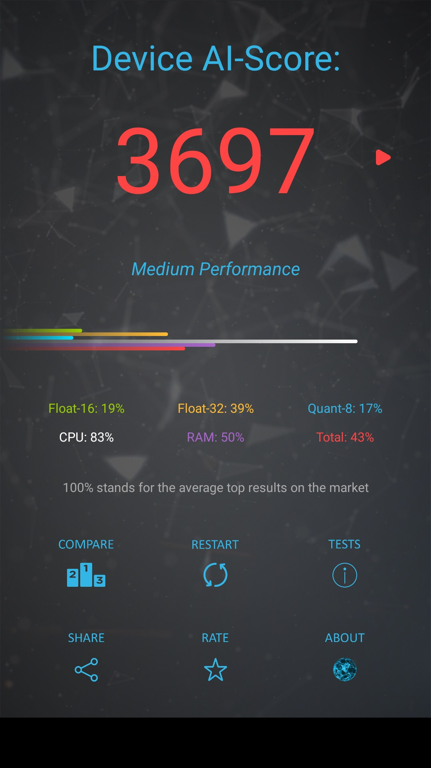
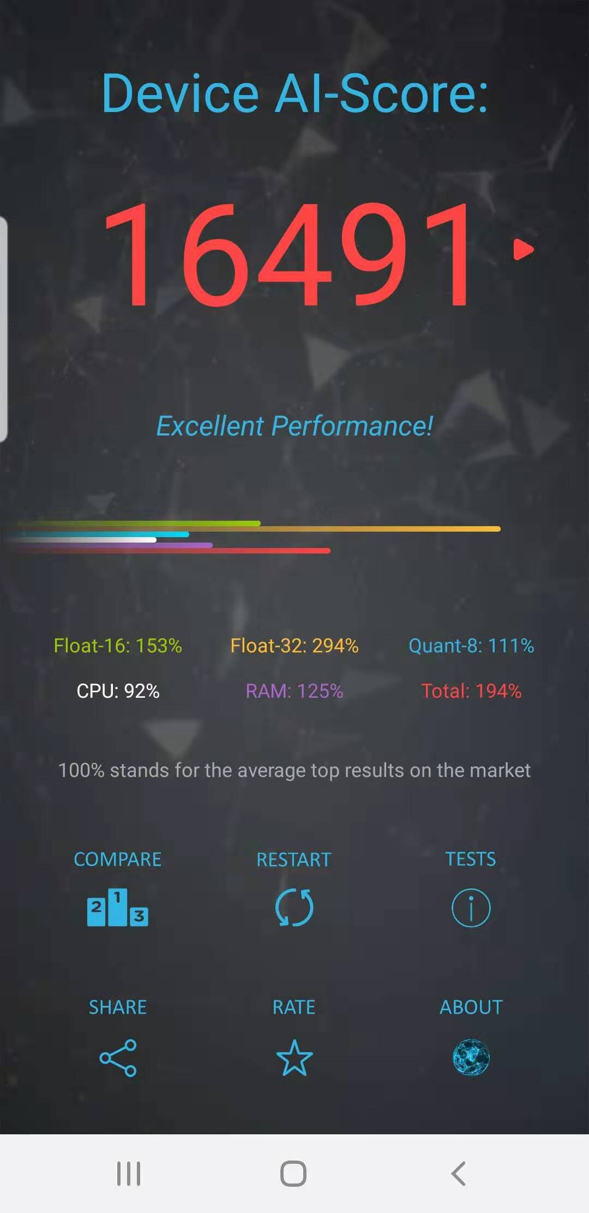
AI Benchmark: Running Deep Neural Networks on Android Smartphones
ETH Zurich University examines the current state of Deep Learning (DL) on Android platforms, ranks existing frameworks and programming models, and identifies the limitations for running AI on smartphones.
Official Link: http://ai-benchmark.com/
Ranking List: http://ai-benchmark.com/ranking.html
Paper Link: https://arxiv.org/pdf/1810.01109.pdf
Google Pixel 2
Samsung S9+
Model Link: \\10.200.210.33\Dropbox\lianming\AI Benchmark

Slide 3
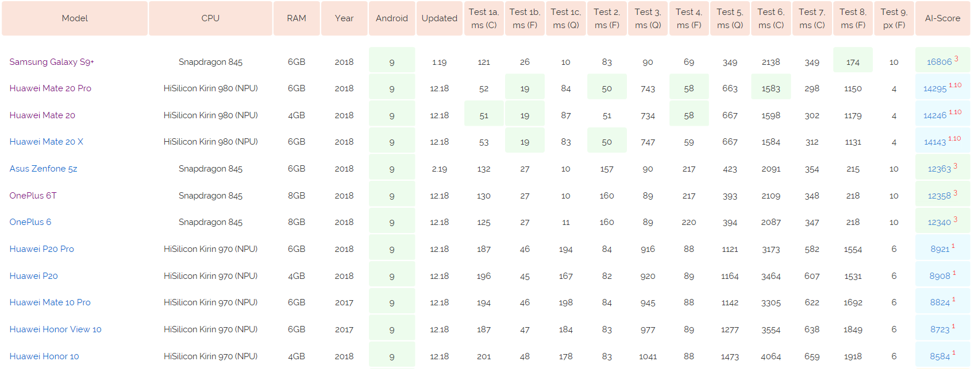
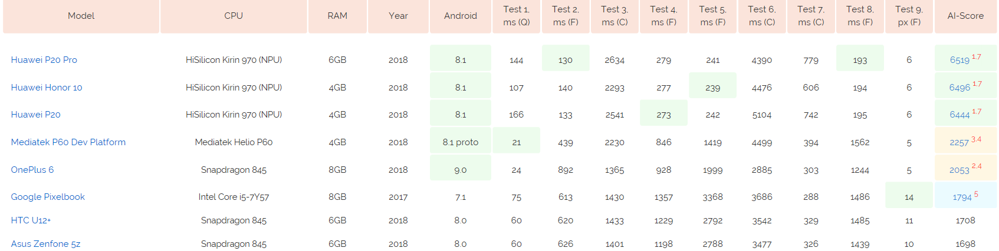
Version2.1.2
Version2.0.0
Q: Quantized model with NNAPI F: Floating model with NNAPI C: CPU excution

Slide 4
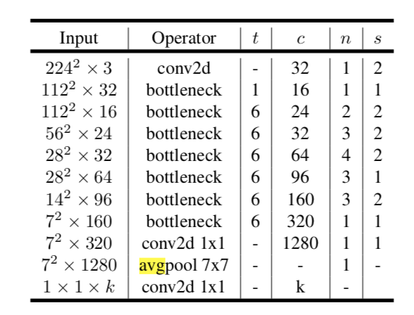
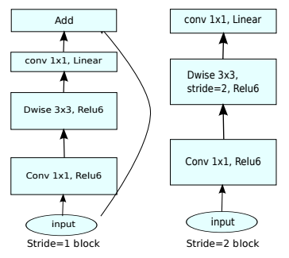
Task 1: Mobile v2 (Object Detection) 4.3MB
Quantization: FLOAT32 INT8 8-bit ﬁxed point
bottleneck

Slide 5
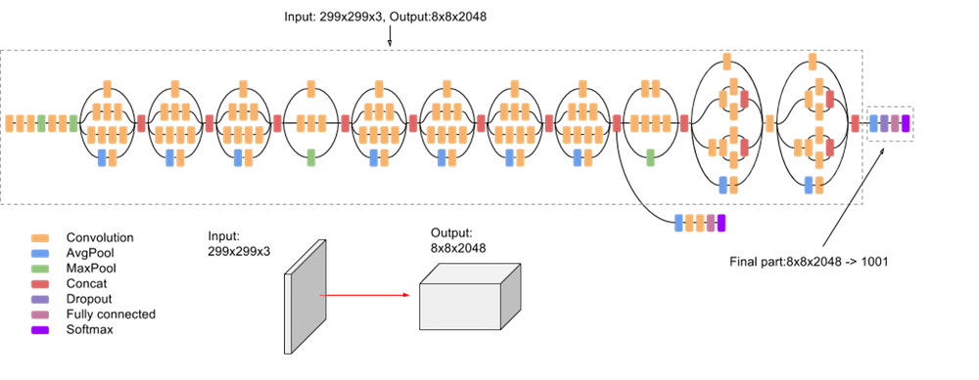
Task 2: Inception v3 (Object Detection) 96MB
Special OP: 1x1, 1x3+3x1,1x7+7x1 CONV

Slide 6
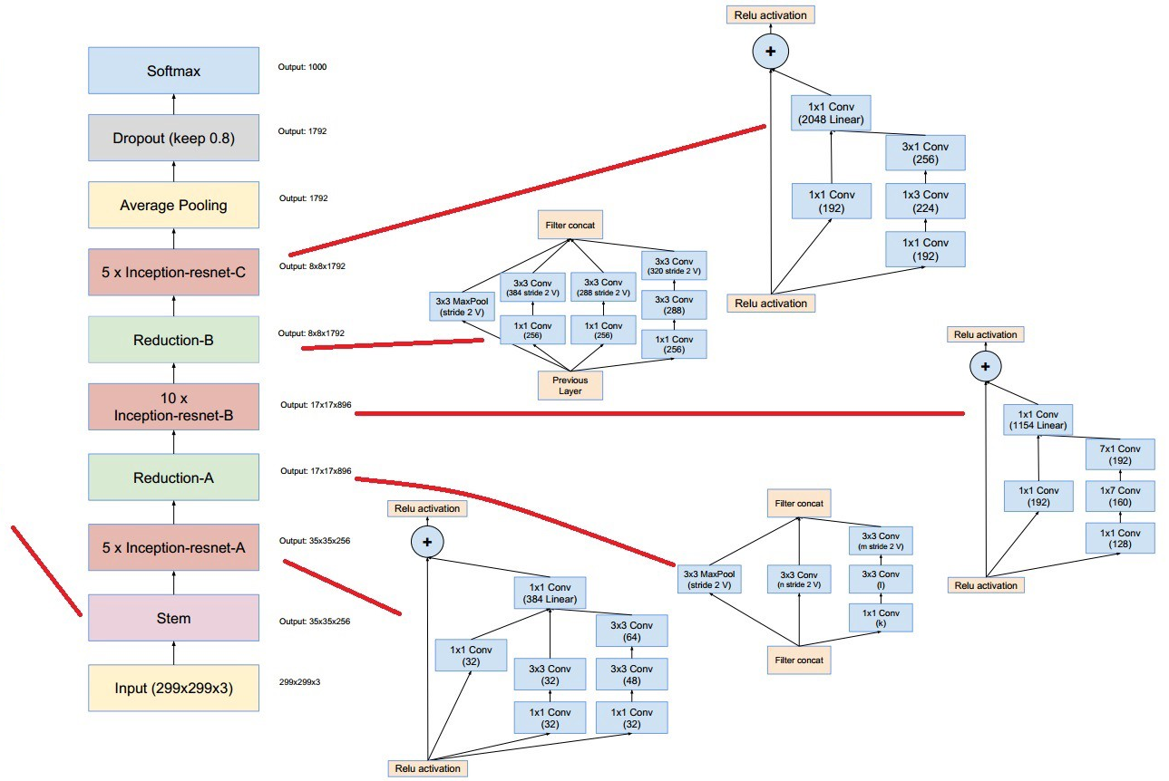
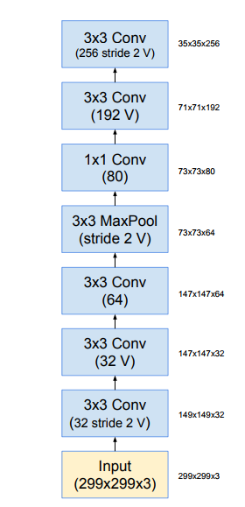
Task 3: Inception ResNet v1 (Face Recognition) >100MB
Special OP: 1x1, 1x3+3x1,1x7+7x1 CONV

Slide 7
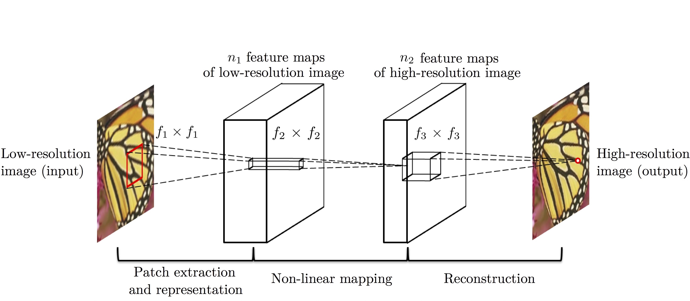
Task 4: SRCNN (Image Deblur) 278KB
64 Feature Map
32Feature Map
9x9
1x1
5x5

Slide 8
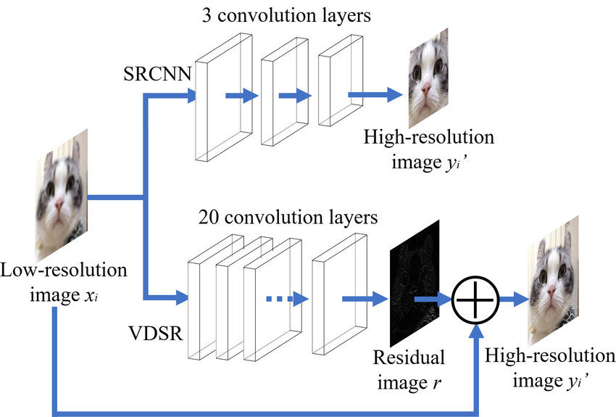
Task 5: VGG19 (Super Resolution) 2.7MB
VGG-19: Dense layer Conv and Residual layer

Slide 9
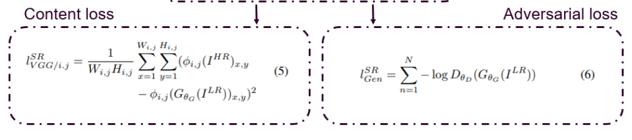
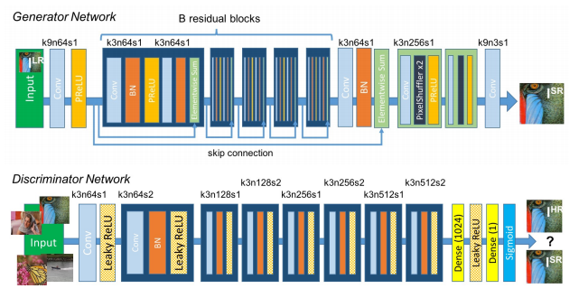
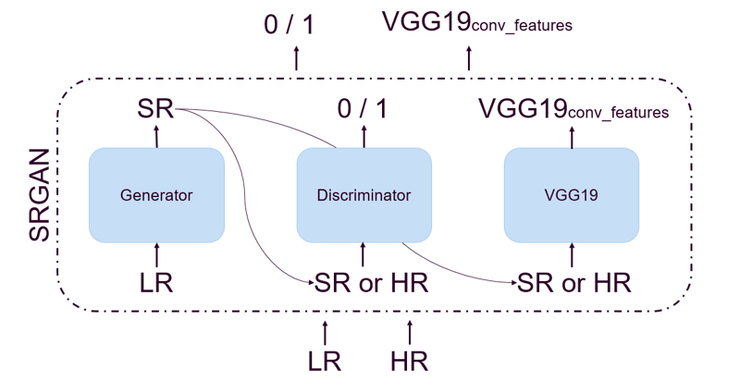
Task 6: SRGAN (Super Resolution) 6.2MB

Slide 10
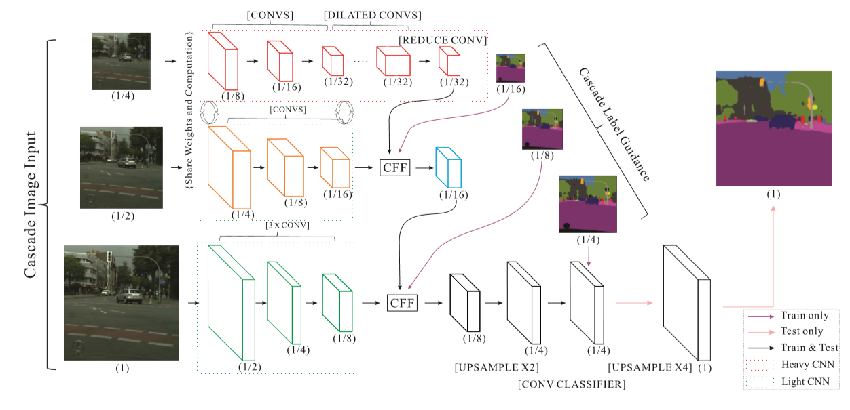
Task 7: ICNet (Semantic Segmentation) 27MB
Pyramid Scene Parsing Network
Special OP: Down/Upsampling

Slide 11
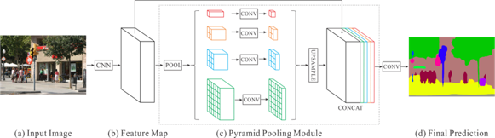
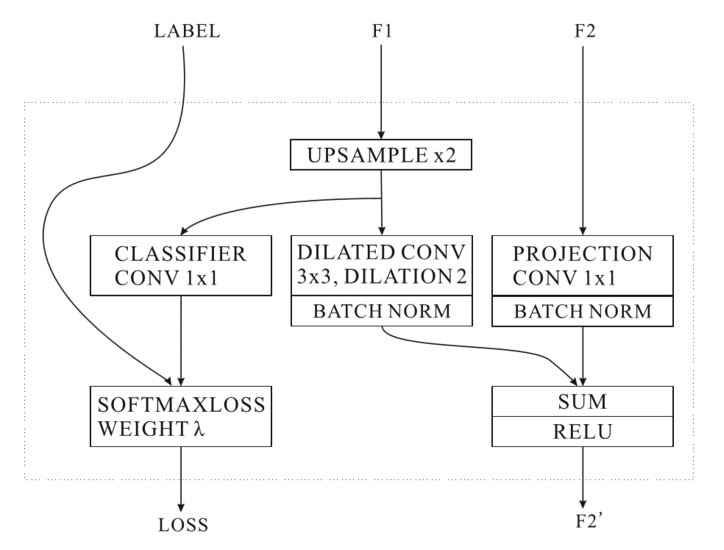
Task 7: ICNet (Semantic Segmentation) 27MB
Pyramid Scene Parsing Network :
Cascade Feature Fusion (CFF) :
Special OP: Dilated CONV

Slide 12
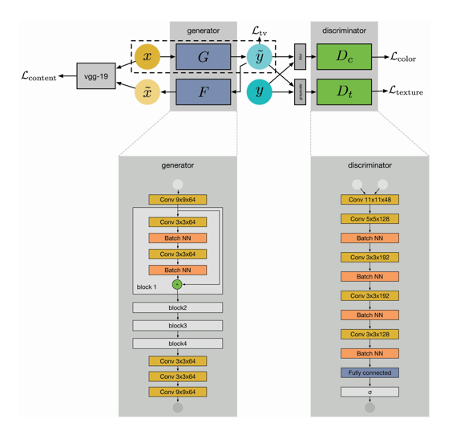
Task 8: Resnet 12 (Photo Enhancement) 1.2MB
Input Image
Resnet-12

Slide 13
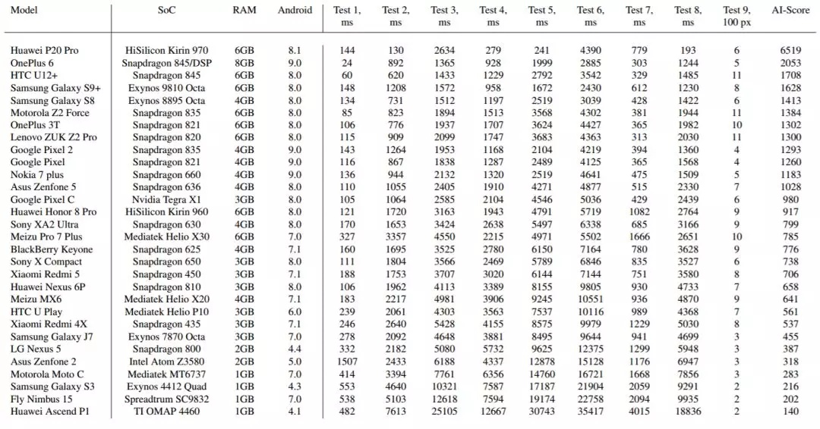
AI Benchmark Score on Test 1 - 9
The scores for the ﬁrst eight tests are computed inversely proportional to the corresponding average runtimes
The score for the memory test is proportionate to the maximum image size that the network was able to process.
The ﬁnal AI score is calculated as a weighted sum of the scores obtained in these nine tests and represents the aggregated AI performance of a particular device.

Slide 14
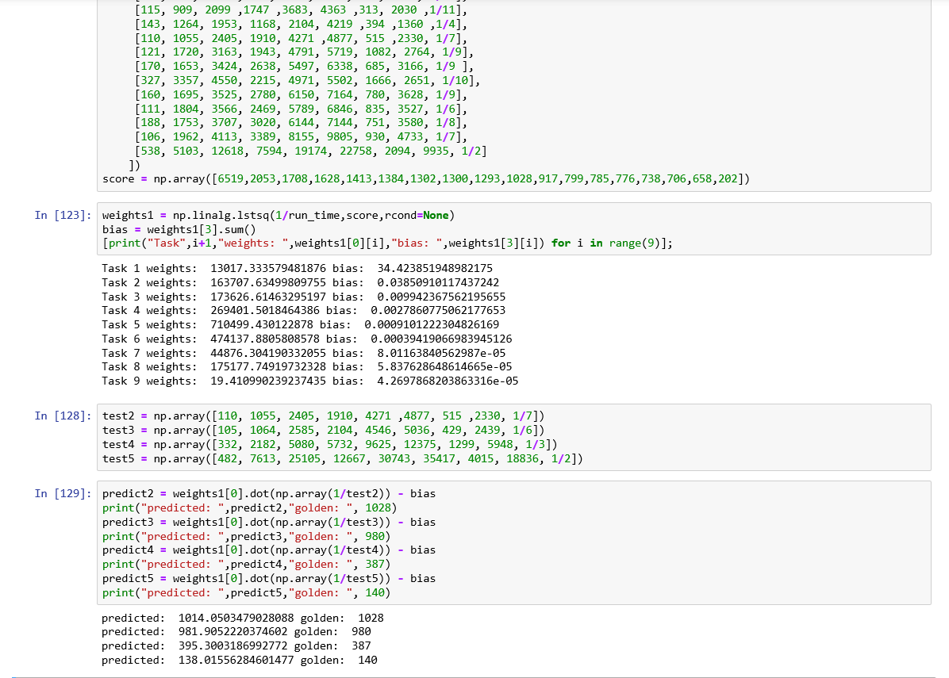
AI Score Weights

Slide 15
AI Benchmark Score on Test 1 - 9
Score
Score
Score
Score
Score
Score
Score
Score
Score
90 1259 65 965 2948 108 57 907 116
542 183 127 290 355 164 148 140 97
216 264 121 219 254 133 136 117 213
87 135 110 281 424 195 73 142 155
97 223 114 225 282 156 104 123 116
153 198 91 178 199 110 117 90 213
122 210 89 157 196 107 122 88 194
113 180 82 154 192 108 143 86 213
91 129 88 230 337 112 113 128 77
Demo: https://www.youtube.com/watch?v=gqRImzUe0YA

Slide 16
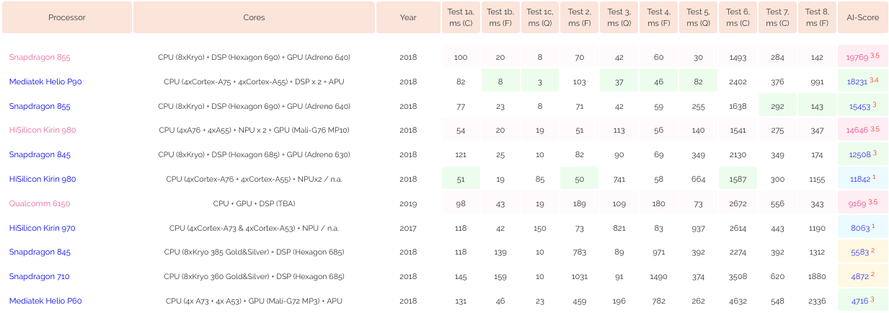
AI Benchmark Score on Test 1 - 8
Kneron KDP 720 2.9 24 22 2.5 22 N/A 5.5 11 187331
Kneron KDP 520P 20 N/A N/A 52 271 N/A 40 234
Kneron KDP 520 24 N/A N/A 56 292 N/A 54 251

